Slide 1
Local Search Algorithms

Slide 2
Local Search Algorithms
Local search algorithms operate by searching from a start state to neighboring states, without keeping track of the paths, nor the set of states that have been reached.
That means they are not systematic—they might never explore a portion of the search space where a solution actually resides.
However, they have two key advantages:
they use very little memory; and
they can often find reasonable solutions in large or infinite state spaces for which systematic algorithms are unsuitable.
Local search algorithms can also solve optimization problems, in which the aim is to find the best state according to an objective function.

Slide 3
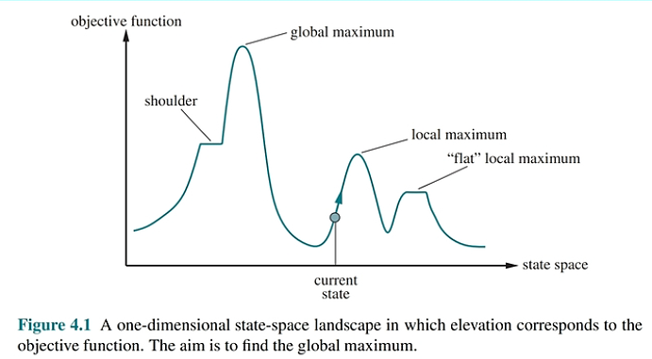

Slide 4
Each point (state) in the landscape has an “elevation,” defined by the value of the objective function.
If elevation corresponds to an objective function then the aim is to find the highest peak—a global maximum—and we call the process hill climbing.
If elevation corresponds to cost, then the aim is to find the lowest valley—a global minimum—and we call it gradient descent.

Slide 5
Hill-climbing search
It keeps track of one current state and on each iteration moves to the neighbouring state with highest value
that is, it heads in the direction that provides the steepest ascent.
It terminates when it reaches a “peak” where no neighbour has a higher value.
Hill climbing does not look ahead beyond the immediate neighbours of the current state.

Slide 6
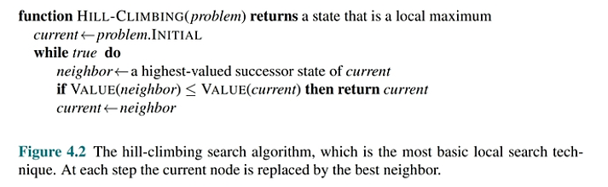

Slide 7
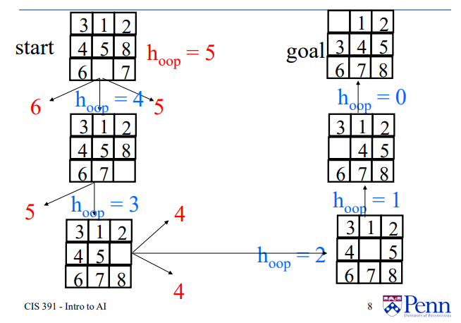
Hill Climbing: Example (Minimizing h)

Slide 8
Hill Climbing: Example (Minimizing h)

Slide 9
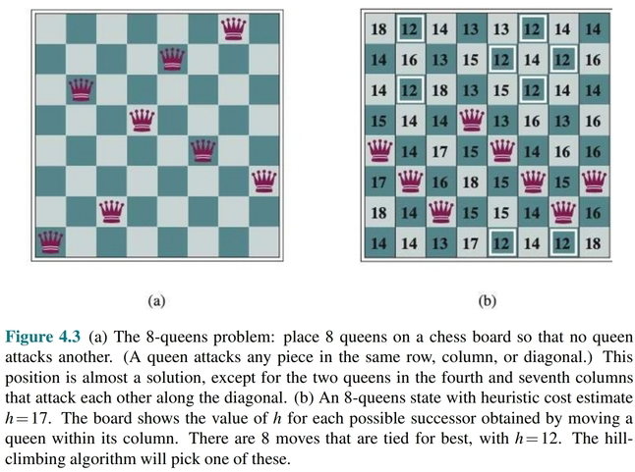

Slide 10
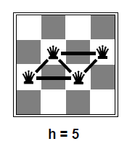
Reduce the number of conflicts

Slide 11
Hill climbing is sometimes called greedy local search because it grabs a good neighbor state without thinking ahead about where to go next.
Hill climbing can get stuck for any of the following reasons:
Local maxima: A local maximum is a peak that is higher than each of its neighboring states but lower than the global maximum.
Ridges: Ridges result in a sequence of local maxima that is very difficult for greedy algorithms to navigate.
Plateaus: A plateau is a flat area of the state-space landscape

Slide 12
Types of Hill Climbing Algorithms
Stochastic hill climbing: chooses at random from among the uphill moves; the probability of selection can vary with the steepness of the uphill move.
First-choice hill climbing: implements stochastic hill climbing by generating successors randomly until one is generated that is better than the current state.
Random-restart hill climbing: It conducts a series of hill-climbing searches from randomly generated initial states, until a goal is found.

Slide 13
A hill-climbing algorithm that never makes “downhill” moves toward states with lower value (or higher cost) is always vulnerable to getting stuck in a local maximum.
In contrast, a purely random walk that moves to a successor state without concern for the value will eventually stumble upon the global maximum, but will be extremely inefficient.
Combination of hill climbing with a random walk in a way that yields both efficiency and completeness.

Slide 14
Simulated annealing
In metallurgy, annealing is the process used to temper or harden metals and glass by heating them to a high temperature and then gradually cooling them, thus allowing the material to reach a low-energy crystalline state.
Simulated-annealing solution is to start by shaking hard (i.e., at a high temperature) and then gradually reduce the intensity of the shaking (i.e., lower the temperature).
Instead of picking the best move, however, it picks a random move. If the move improves the situation, it is always accepted.
Otherwise, the algorithm accepts the move with some probability less than 1.

Slide 15
Basic idea:
Allow “bad” moves occasionally, depending on “temperature”
High temperature => more bad moves allowed, shake the system out of its local minimum
Gradually reduce temperature according to some schedule
Sounds pretty flaky, doesn’t it?

Slide 16
Simulated annealing algorithm
function SIMULATED-ANNEALING(problem,schedule) returns a state
current ← problem.initial-state
for t = 1 to ∞ do
T ←schedule(t) if T = 0 then return current next ← a randomly selected successor of current
∆E ← next.value – current.value if ∆E > 0 then current ← next else current ← next only with probability e^{∆E/T}

Slide 17
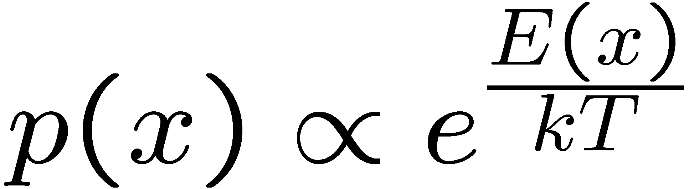
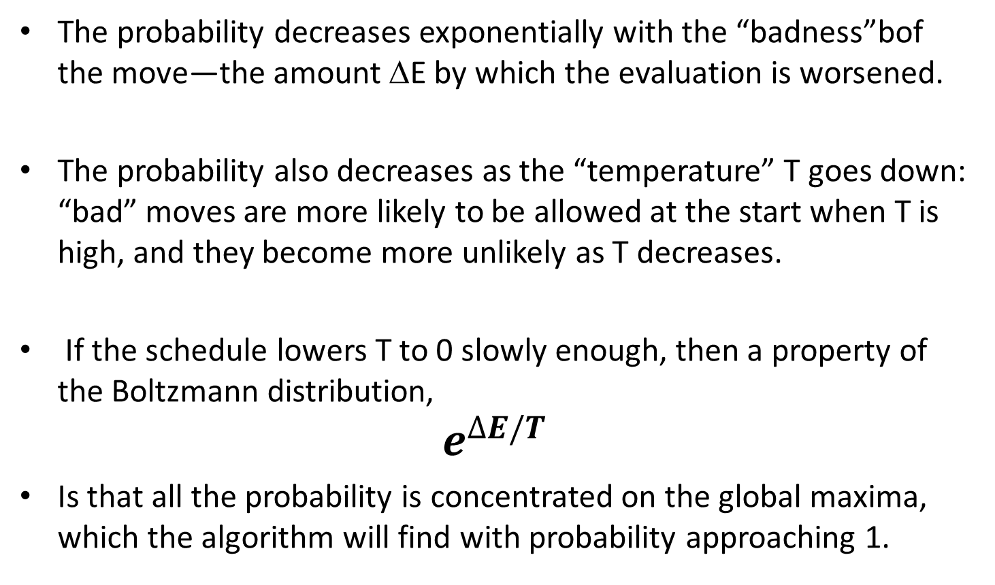
Simulated Annealing
The probability decreases exponentially with the “badness”bof the move—the amount ΔE by which the evaluation is worsened.
The probability also decreases as the “temperature” T goes down: “bad” moves are more likely to be allowed at the start when T is high, and they become more unlikely as T decreases.
If the schedule lowers T to 0 slowly enough, then a property of the Boltzmann distribution,
$$e^{∆E/T}$$
Is that all the probability is concentrated on the global maxima, which the algorithm will find with probability approaching 1.
Notes:
P(x)P(x->y) = P(y)P(y->x)
P(x)/D = P(y)exp((E(x)-E(y))/T)/D
P(x)/P(y) = exp(E(x)/T) / exp(E(y)/T)

Slide 18
Simulated Annealing
Is this convergence an interesting guarantee?
Sounds like magic, but reality is reality:
The more downhill steps you need to escape a local optimum, the less likely you are to ever make them all in a row
“Slowly enough” may mean exponentially slowly
Random restart hillclimbing also converges to optimal state…
Simulated annealing and its relatives are a key workhorse in VLSI layout and other optimal configuration problems

Slide 19
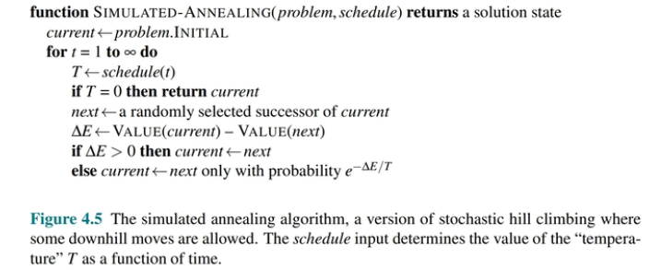

Slide 20
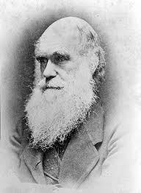
Local beam search
Basic idea:
K copies of a local search algorithm, initialized randomly
For each iteration
Generate ALL successors from K current states
Choose best K of these to be the new current states
Why is this different from K local searches in parallel?
The searches communicate! “Come over here, the grass is greener!”
What other well-known algorithm does this remind you of?
Evolution!

Slide 21
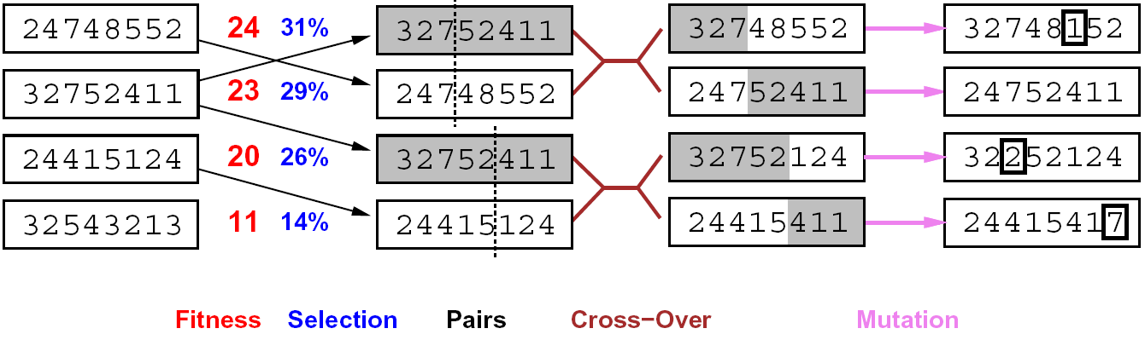
Genetic algorithms
Genetic algorithms use a natural selection metaphor
Resample K individuals at each step (selection) weighted by fitness function
Combine by pairwise crossover operators, plus mutation to give variety

Slide 22
Example: N-Queens
Does crossover make sense here?
What would mutation be?
What would a good fitness function be?

Slide 23
Summary
Many configuration and optimization problems can be formulated as local search
General families of algorithms:
Hill-climbing, continuous optimization
Simulated annealing (and other stochastic methods)
Local beam search: multiple interaction searches
Genetic algorithms: break and recombine states
Many machine learning algorithms are local searches

Slide 24
Local beam search
Basic idea:
K copies of a local search algorithm, initialized randomly
For each iteration
Generate ALL successors from K current states
Choose best K of these to be the new current states
Why is this different from K local searches in parallel?
The searches communicate! “Come over here, the grass is greener!”
What other well-known algorithm does this remind you of?
Evolution!
Or, K chosen randomly with a bias towards good ones

Slide 25
Genetic algorithms
Genetic algorithms use a natural selection metaphor
Resample K individuals at each step (selection) weighted by fitness function
Combine by pairwise crossover operators, plus mutation to give variety

Slide 26
Example: N-Queens
Does crossover make sense here?
What would mutation be?
What would a good fitness function be?

Slide 27
Summary
Many configuration and optimization problems can be formulated as local search
General families of algorithms:
Hill-climbing, continuous optimization
Simulated annealing (and other stochastic methods)
Local beam search: multiple interaction searches
Genetic algorithms: break and recombine states
Many machine learning algorithms are local searches

